Slide 1



Introduction to
Jan Aernout
Sarah Gerritse
Amsterdam, 3 march 2015

Slide 2

Introducing Senority
Founded by a group of people with deep experience in the services industry who collectively have been challenged over the years because there is no simple "solution" that can help complex client supplier relationships
We have identified the gap, validated the demand, determined the scope and mobilised industry experts and developed Evaluetor©
We have created a solution that consists of 3 pillars
Evaluetor©
Cloud solution,
Process templates
We can Lead or facilitate, your choice
Using experience driven proven processes
Advisory group
Strength in Knowledge
Experienced advisors that help your organisation with the process framework
Secure processes in a workbench enabling integrated management

Slide 3

Senority invested in Evaluetor ….
To unleash the value contained in contracts by managing expectations and compliance
Automated contract alerts;
Clear view on priorities;
No slippage of contract value;
Early identification of issues and opportunities;
Detection of new/changed requirements
Direct involvement of Business Owners
Status on deliverables;
Procurement Cockpit: Be informed at all times
Transparent and real time reporting to all stakeholders
Automatic recording for compliance
Transparent collaboration environment
Shared dash-boarding;
Improved collaboration internally and with suppliers;
Uniform reporting
One Truth
Internal and external (KPI) perception measurement;
Focus on Your and Suppliers expectations while delivering the contracts;
Pro-active governance;
Smart actions shared in teams… and with suppliers
Clear assignments to teams
Increase Client satisfaction
Avoid switch cost of strategic partners
De-risked portfolio
Leading indicators
Decrease operational cost
Achieve intention of contract

Slide 4
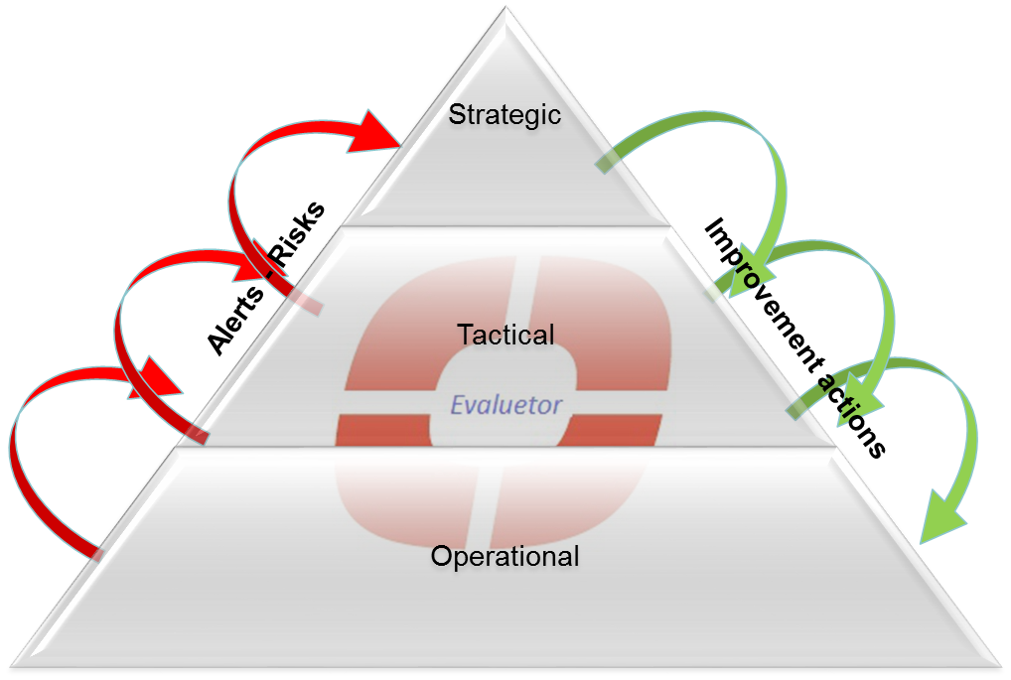
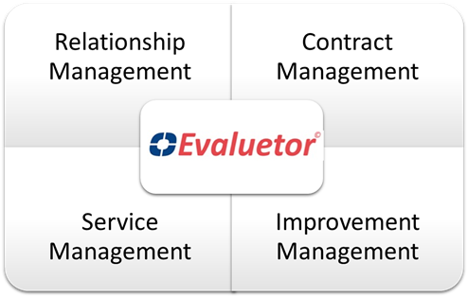
Evaluetor delivers…
Benefits
Ability to pro-actively manage contract conditions and risks
Automatic prompts contract conditions
High level overview of all contract- and relationship statuses with ability to drill down to actual underlying issues
Full transparency of day-to-day status of strategic relationships
Integrated relationship management approach: both suppliers and Business Users
Continuous improvement based on actual issues and observations
Dedicated focus on “go-to-green” improvement actions
Clear roles, responsibilities and ownership for relationship responsibilities
Intercompany communication vehicle
Compliance documented during normal business operation
Business value
Increase Sourcing satisfaction by 10-25%
Improve Supplier delivered value by 15%
Reduce operational cost (cost avoidance) by 5 %
Reduce operational risks by 20 %

Slide 5
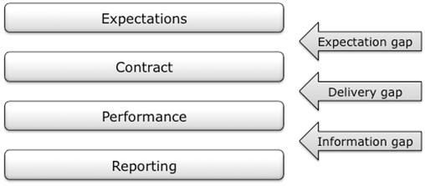
Closing the Gap’s

Slide 6


Internal Management and Control
Control structure
Ops
Finance
Legal
Organisation, Teams, Actions
Budgets,
Actuals, Targets
Policy
Contracts, Commitments
Risk,
Mitigation
Measurements
Change
Sales
Account Mgt
Delivery
Marketing
Operational Value Chain

Slide 7

as Ecosystem
Collaboration
Shared
Business Relationship
Contracts, Commitments
Teams, Actions
Control structure
Control structure
Ops
Finance
Legal
Ops
Finance
Legal
Perception
Organisation, Teams, Actions
Budgets,
Actuals, Targets
Policy
Organisation, Teams, Actions
Budgets,
Actuals, Targets
Policy
Contracts, Commitments
Contracts, Commitments
Risk,
Mitigation
Contract /SLA
Risk,
Mitigation
Measurements
Change
Measurements
Change
Performance
Sales
Account Mgt
Delivery
Marketing
Sales
Account Mgt
Delivery
Marketing
Operational Value Chain
Reporting/Control
Operational Value Chain

Slide 8
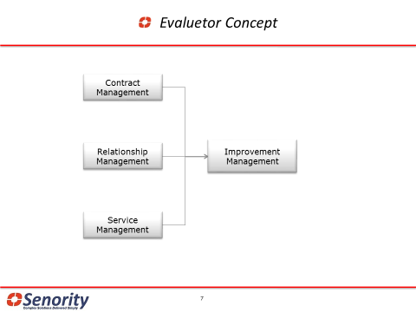
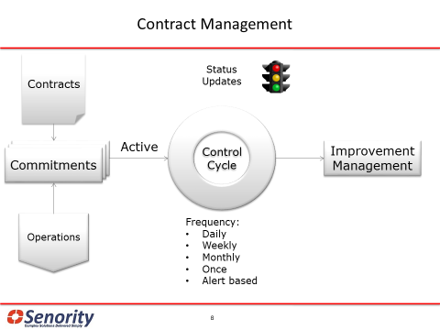
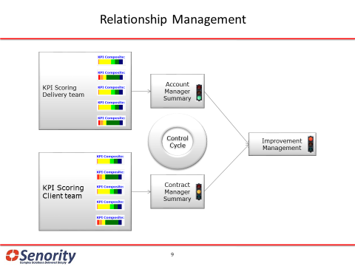
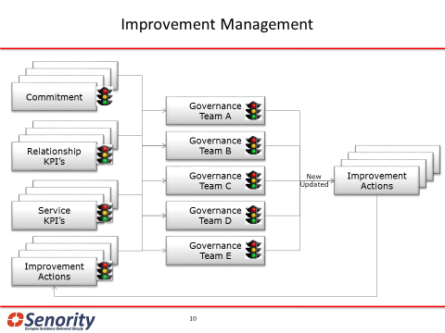
Evaluetor at a glance..

Slide 9
How the information comes together
Evaluetor Monitor
Contract performance
Improvement
Plan Status
Contracts
Upload
Contracting (client & supplier)
Go to Green status collection
Services Metric collection (SLA)
Delivery Performance
Project
Metric
Collection
Alerts
Supplier
Account Staff
Supplier Delivery Staff
Supplier
Team Score
Client
Staff Score
Client Interview
Web based Survey
Perception based
Fact based

Slide 10

Evaluetor Application Components
Evaluetor
Business Structures
Status and Collaboration
For both internal & external
Organisation
Client Relationships
Contracts
Projects
Services
Vendor Relationships
Contracts
Projects
Services
Performance Indicators
Scoring Scales
Score
Commitments, Deliverables & Risk
Status
Alert rules
Governance
Measurement
Facts on operations:
ERP
HR
F&A
CRM
Measurement
Measurement
Perceptions
of
involved People
Measurement
Measurement

Slide 11
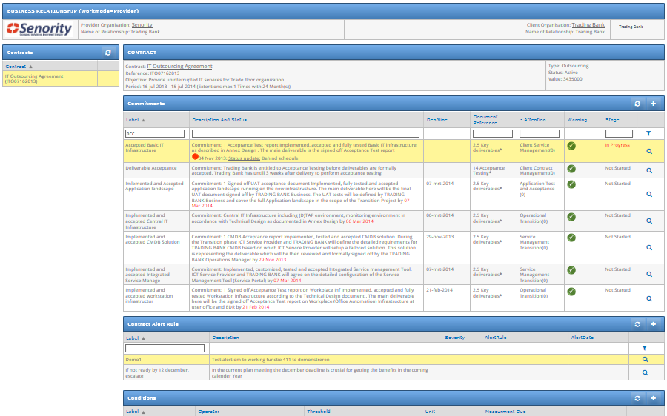

Translate your Contract Documents into
manageable Commitments, Actions and Alerts

Slide 12
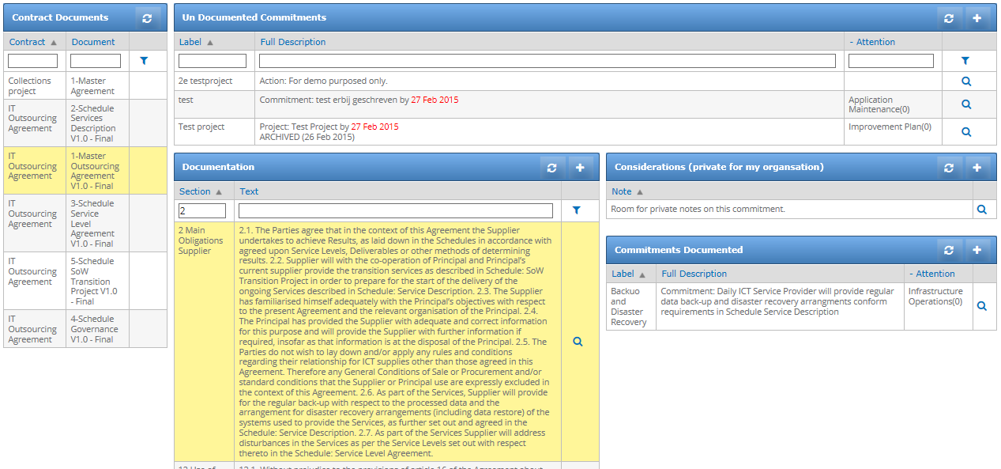
Relating business commitments, contract language, and additional considerations

Slide 13
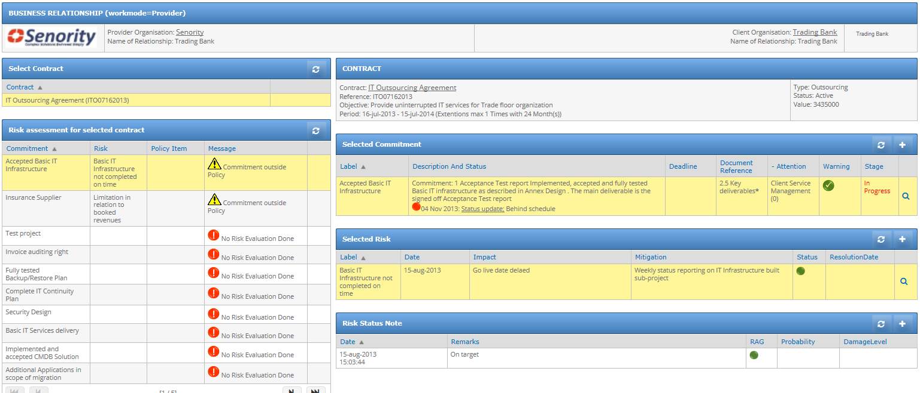
Risk Register

Slide 14
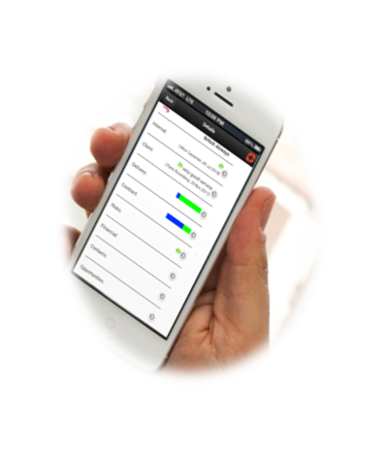
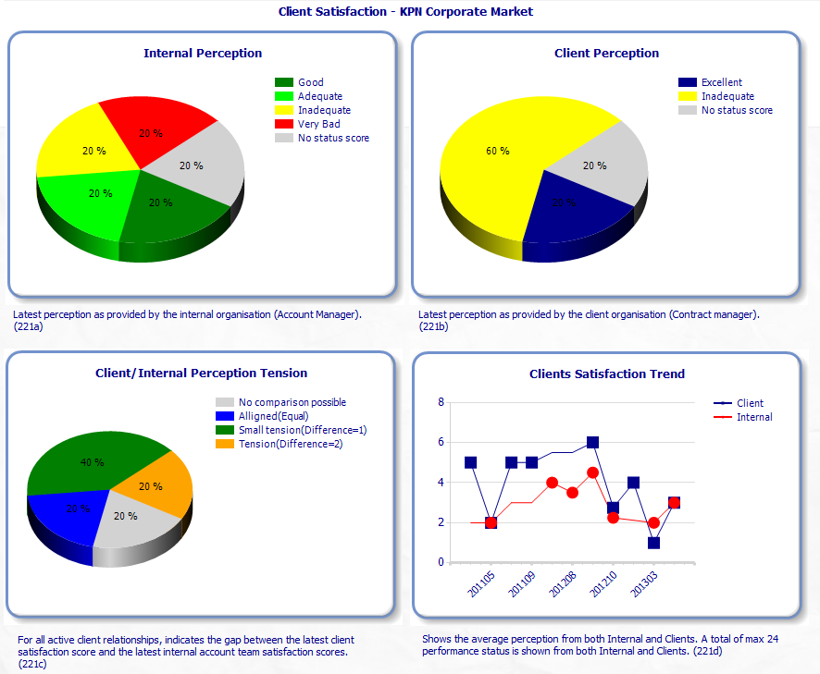
Evaluetor Executive Monitor
Making Business Relationships
“Transparent, Measurable and Actionable”

Slide 15
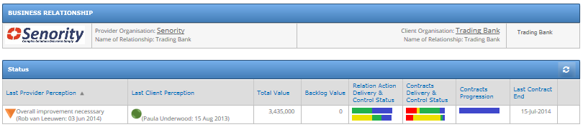
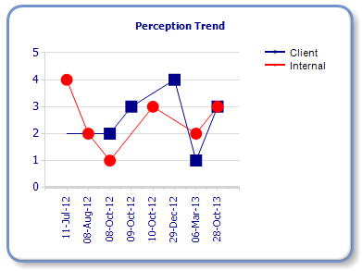
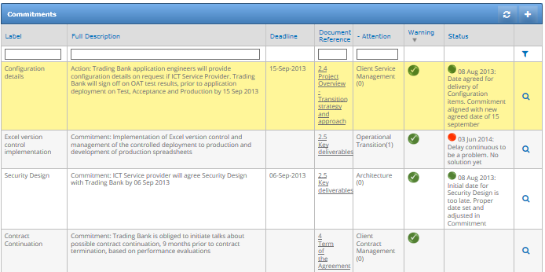
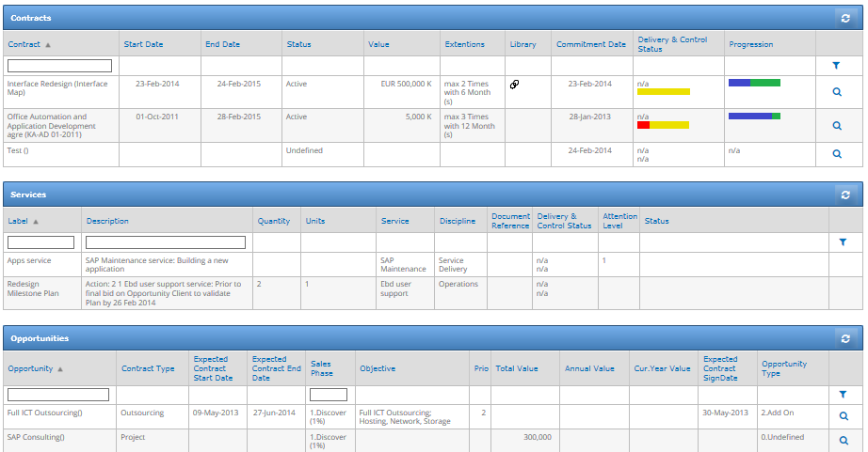
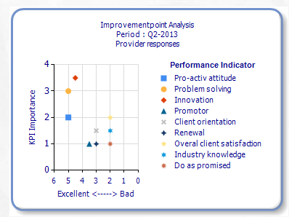
Contract Managers Dashboards
Maximize the return on contracts

Slide 16
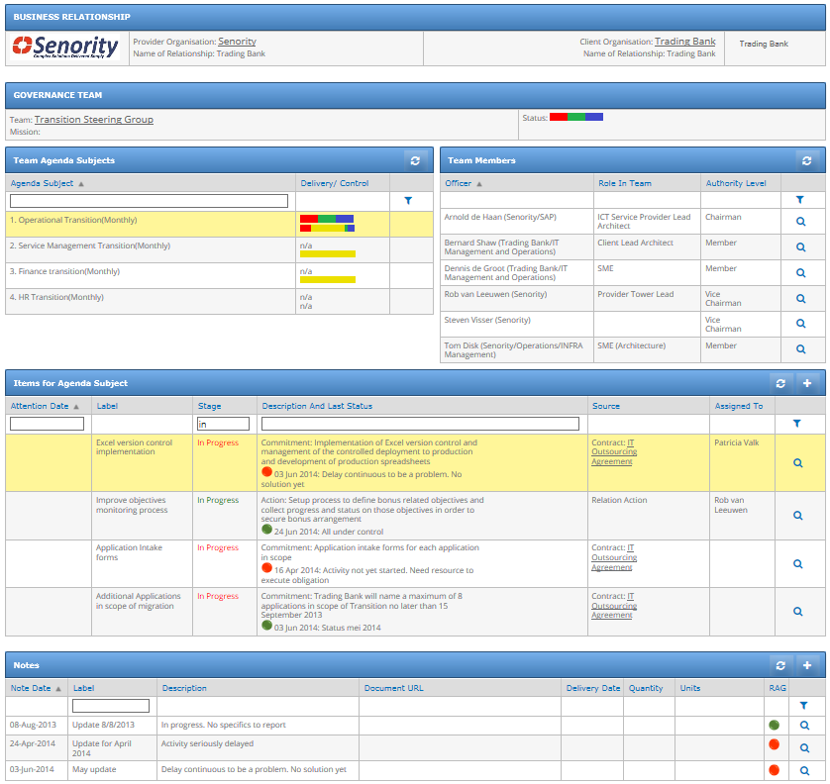
Governance Team Collaboration (Provider & Client)
Evaluetor helps you to install a client driven continuous improvement process with your supplier community.
Bringing insight and visibility on the quality of provided services versus your business needs…….. and the perception thereof.

Slide 17
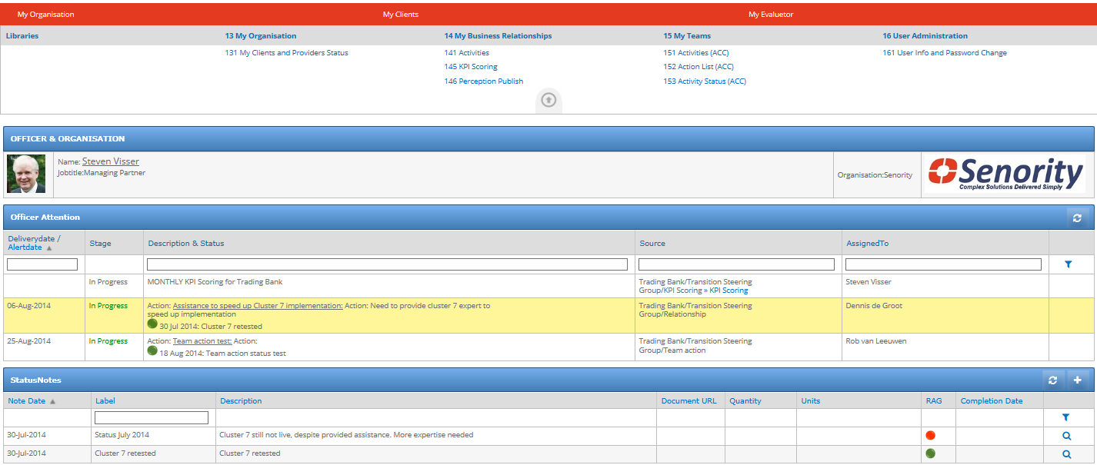
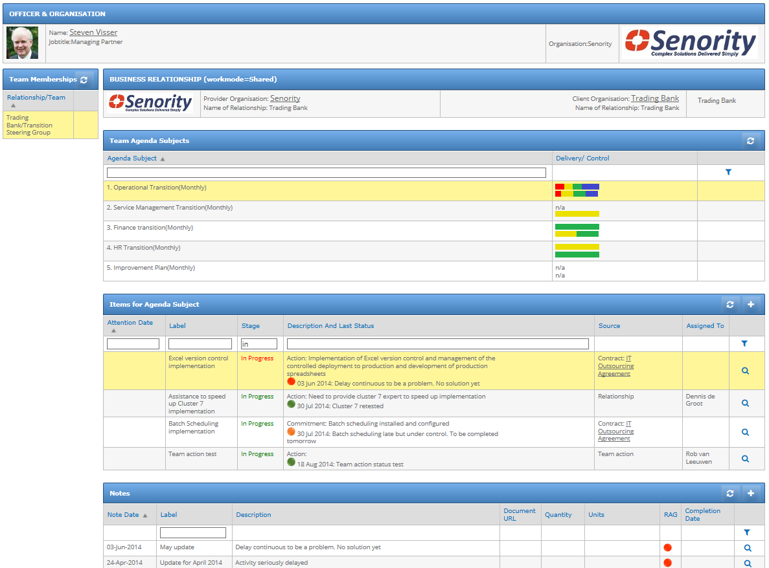
My Evaluetor
My Evaluetor brings together all YOUR actions and alerts from your contracts, projects and teams
My Teams : working together with real-time status on all agenda items with feeds from your Business Relations, Colleagues and Evaluetor provided information

Slide 18
Contact
Steven Visser Managing Partner - Senority Boompjes 680 3011 XZ Rotterdam
The Netherlands Tel: +31 (0) 10 217 0118 Fax: +31 (0) 10 213 0133 Steven.Visser@senority.nl www.senority.nl

Slide 19


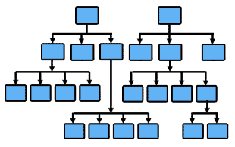


How does it work?
EvaluetorApps
Browser
Evaluetor
Authorisation DB
Sharepoint DB
Evaluetor DB
Users interact through various devices through the internet into the website structure, where the webparts interact with the databases

Slide 20
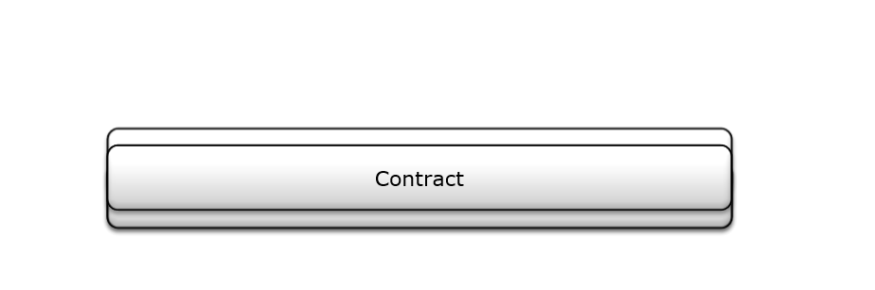
Evaluetor.. Closing the Gap

Slide 21
Evaluetor
Contract
Management
Relationship
Management
Improvement
Management
Service
Management

Slide 22
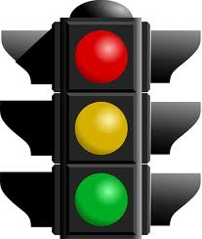
Contract Management
Contracts
Status
Updates
Control
Cycle
Active
Improvement
Management
Commitments
Operations
Frequency:
Daily
Weekly
Monthly
Once
Alert based

Slide 23





Relationship Management
KPI Scoring
Delivery team
Account Manager
Summary
Control
Cycle
Improvement
Management
KPI Scoring
Client team
Contract
Manager
Summary

Slide 24

Improvement Management
Commitment
Governance
Team A
Governance
Team B
Relationship
KPI’s
Governance
Team C
New
Updated
Improvement
Actions
Service
KPI’s
Governance
Team D
Governance
Team E
Improvement
Actions

Slide 25
Creates External Focus !!
Client Organisation
Maximize the return on contracts
Perception Management
Shared Governance
Shared commitment
Status
(real-time)
Sales
Account Mgt
Delivery
Marketing
Portfolio
Opportunity
Contract
Provider Organisation
Service

